Slide 1
Data Mining 2 Supervised Learning
ENSAMBLE LEARNING
Dr. Shailesh Kumar
ISB/CBA

Slide 2
Model model everywhere…
Unsupervised – projection, grouping, density estimation
PCA, K-Means, Mixture-of-Gaussians
Supervised – Classification
Fisher, Perceptron, Logistic, Neural Networks, SVM
Decision Trees, K-Nearest Neighbor, Parzen Window
Bayesian Classifiers – LDA, QDA, Naïve Bayes
Supervised – Regression
Linear Regression, Polynomial Regression, etc.
How to Handle Increasing Complexity of Decision Boundaries?

Slide 3
1. Choose COMPLEX Models
Example:
Choose Multi-Layered-Perceptron vs. Logistic Regression
Choose Polynomial Support Vector Machines vs. Linear SVM
Needs:
More training data and More training time
Careful tuning of parameters – Bias/Variance Tradeoff
Training Set Accuracy
Right Level of Model Complexity
Model Accuracy
Validation Set Accuracy
Model Complexity

Slide 4
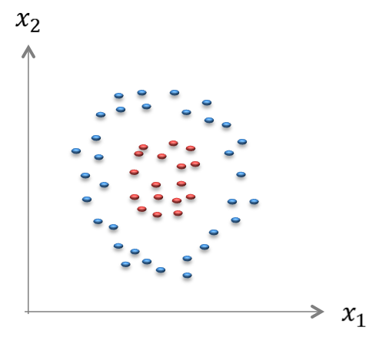
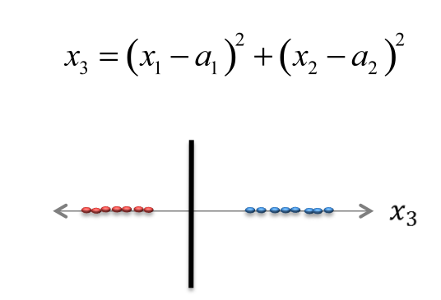
2. Engineer Better Features
Simple Features
Complex Model
Complex
Features
Simple
Model

Slide 5
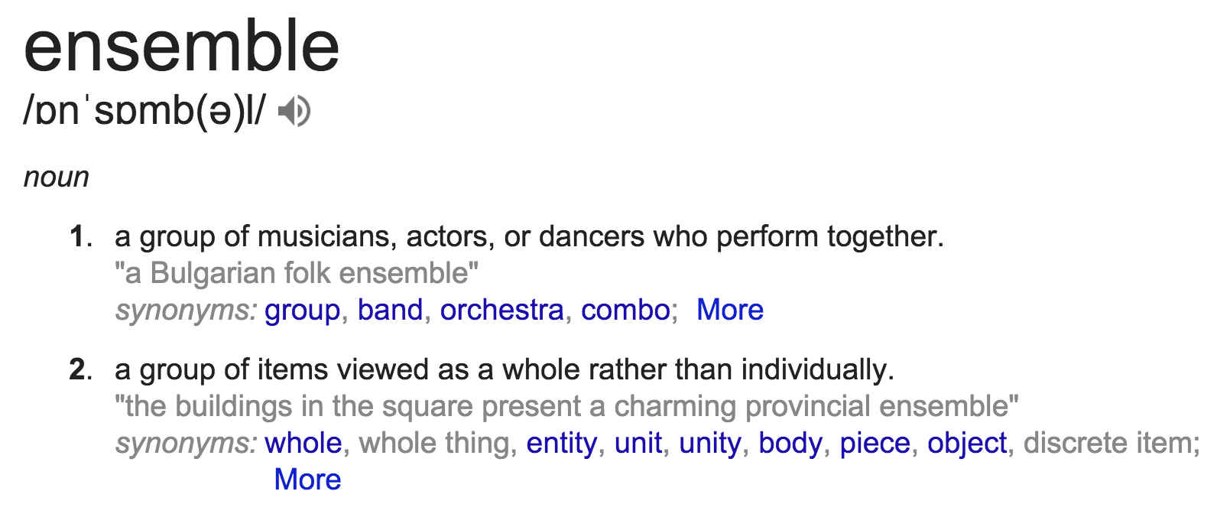
3. Divide and Conquer
Instead of trying to learn a SINGLE COMPLEX model can we learn an ENSEMBLE of SIMPLE models and COMBINE their outputs?

Slide 6
Ensemble Learning
INPUT
Space PARTITION
Output Space COMBINER

Slide 7
PARTITION
COMBINER

Slide 8
Different ways to DIVIDE?
Things we CANNOT control
Noise in Training Inputs
Noise in Class Labels
Number of Labeled Examples available
Raw Input
Things we CAN control
Training SAMPLE to use
FEATURES to use
CLASS labels per classifier

Slide 9
Ensemble Learning by TRAINING SAMPLING
BAGGING (Bootstrap Aggregation)

Slide 10
How to find the right model?
Algorithm &
Complexity
Universe of all mappings
Model Inputs are GIVEN
Output Labels are GIVEN
Training Params &
Initialization

Slide 11
Model Selection
Choosing the right modeling ALGORITHM
Choosing the right COMPLEXITY of the modeling technique
Choosing the right training PARAMETERS to train the model
Training Set Accuracy
Right Level of Model Complexity
Model Accuracy
Validation Set Accuracy
Model Complexity

Slide 12
With Same Algorithm & Complexity
Algorithm &
Complexity
Which is the “BEST” model?
Is RANDOM model ok?
Can we build an AVERAGE model?
MODEL AVERAGING
Train SEVERAL Models
Take their AVERAGE

Slide 13
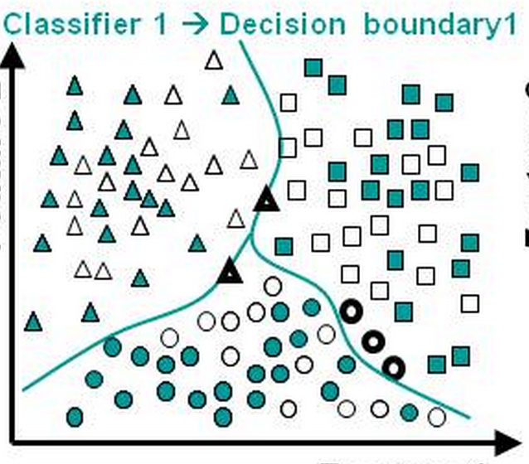
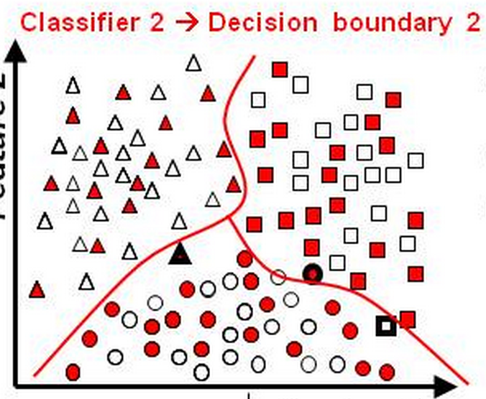
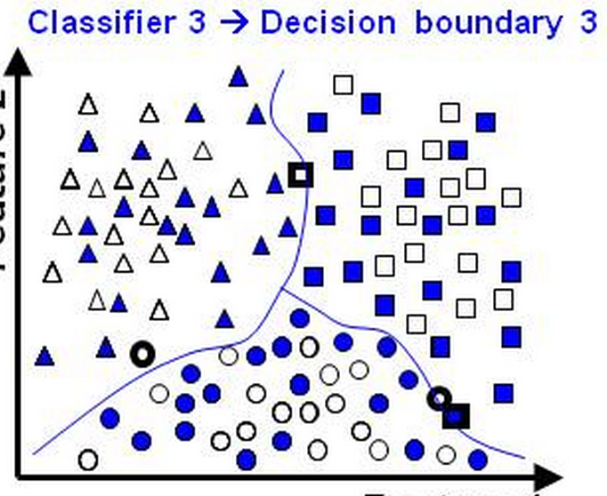
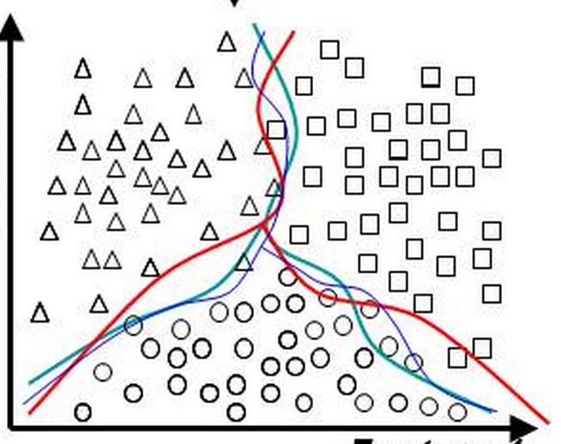
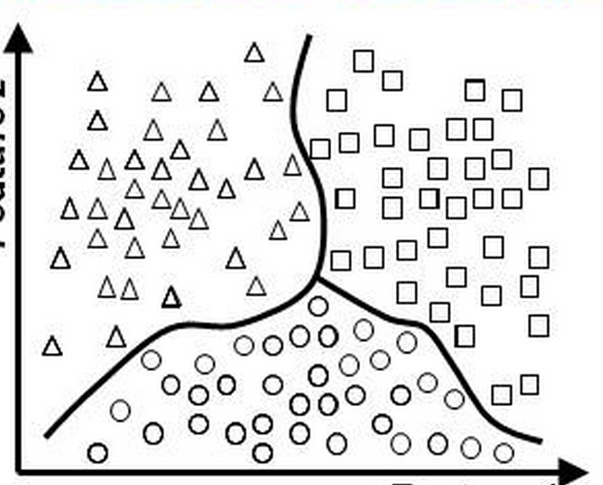
Ensemble by Training Sample

Slide 14
BAGGING (Bootstrap Aggregation)
TRAINING PHASE

Slide 15
BAGGING (Bootstrap Aggregation)
SCORING PHASE

Slide 16
Training data Sampling
INPUT
Space PARTITION
Output Space COMBINER

Slide 17
Ensemble Learning by FEATURE SAMPLING
RANDOM PROJECTIONS
RANDOM FOREST

Slide 18
Projection Methods
Projection Methods – Dimensionality Reduction for
Visualization
De-correlation
Tradition Methods for feature projection
Principal Components Analysis (Multivariate)
Singular Value Decomposition (Multivariate)
Latent Semantic Indexing (Text)
Discrete Cosine Transform (Images)
Problem
Try to “optimize” an objective function
Are not well defined for SPARSE, HIGH DIMENSIONAL data

Slide 19
Random Projections
In High Dimensional Spaces, SPARSE spaces (e.g. TEXT)
Almost all projections are equally “orthogonal” to each other
We can choose k RANDOM projections and project the D dimensional data onto these k projections
ACCURACY
SPEED
PCA, SVD, LSI
CLUSTERING
RANDOM
PROJECTIONS

Slide 20
Decision Tree Classifiers
Easy to TRAIN
Easy to INTERPRET
GREEDY in FEATURES
What if instead of a single decision tree we could train a whole bunch of trees?
One way would be to do BAGGING like before
Is there a BETTER WAY to do this?
PCA : Random Projections :: Decision Trees : ?????

Slide 21
Random Forrest
TRAINING PHASE

Slide 22
Random Forrest
Input

Slide 23
Feature Sampling
INPUT
Space PARTITION
Output Space COMBINER

Slide 24
Ensemble Learning by ITERATIVE REWEIGHTING
BOOSTING (Bootstrap Aggregation)

Slide 25
Adaboost - Setup

Slide 26
Adaboost - Algorithm

Slide 27
Ensemble Learning by INPUT SPACE PARTITION
Mixture of Experts

Slide 28
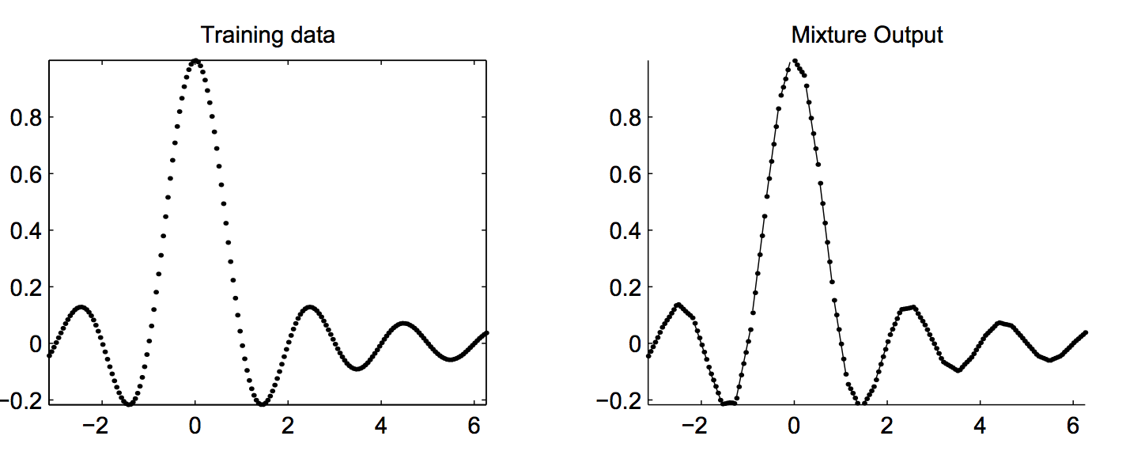
Local Linear Embedding

Slide 29
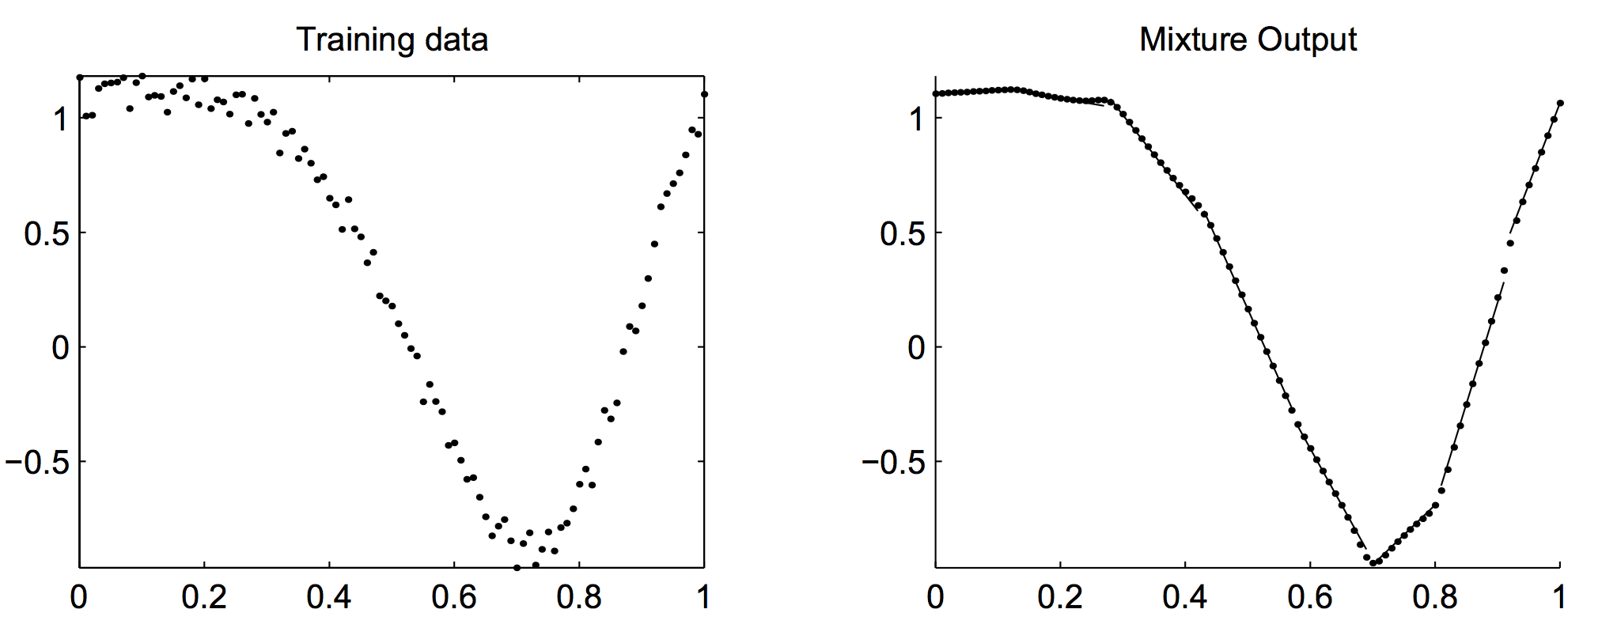
Local Linear Embedding

Slide 30
Ensemble Learning by OUTPUT SPACE PARTITION
Multi-Class Classifiers

Slide 31
Multi-Class C > 2 problems
Most classification Algorithms designed for 2-Class classification problem.
How to extend them for C > 2 class classification problems?
1-vs-REST classification
Skewed classes, complex decision boundary
PAIR-WISE classification
Learn (C choose 2) classifiers
Combine them by voting or other methods
BINARY-HIERARCHICAL CLASSIFIER
Learn a Bottom-up hierarchy of classes

Slide 32
Divide and Conquer Class Hierarchy Discovered in Digits!
2
6
3
8
0
5
4
9
1
7

Slide 33
Binary Hierarchical Classifiers
Better “localized features”
Simpler “local models”
More interpretable features and models
Higher Accuracy
Faster Modeling Time
Lower Resource Requirements
M
W
N
U
F
P
T
A
V
Y
S
Z
B
E
I
J
K
R
X
C
D
L
H
O
G
Q

Slide 34
Binary Hierarchical Classifiers
M
W
N
U
F
P
T
A
V
Y
S
Z
B
E
I
J
K
R
X
C
D
L
H
O
G
Q

Slide 35
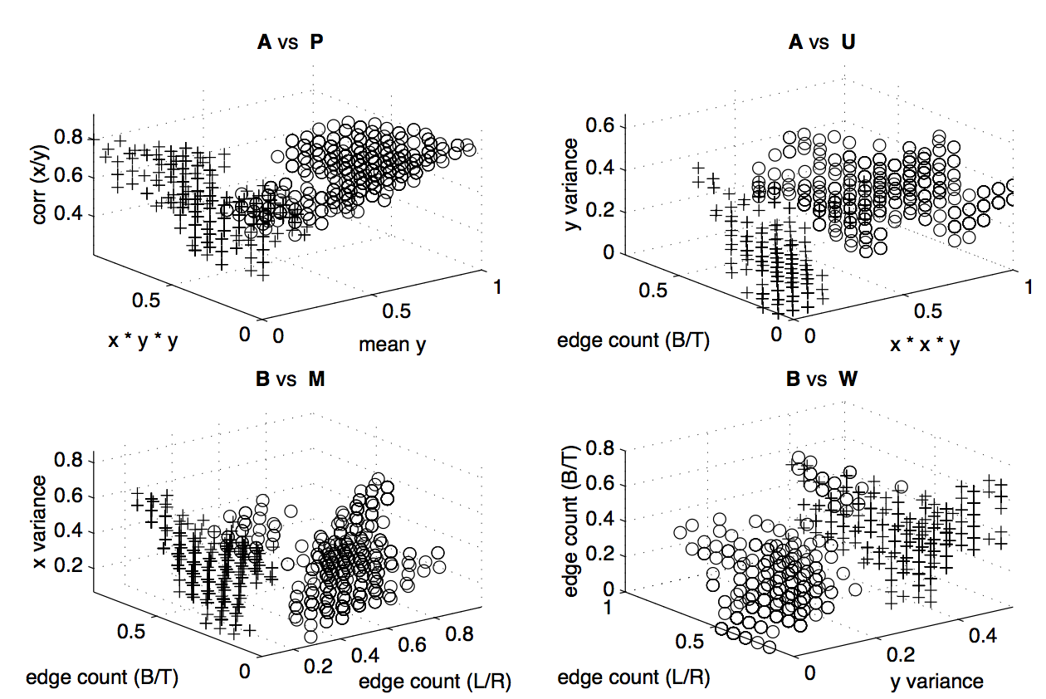
Pair-wise features

Slide 36
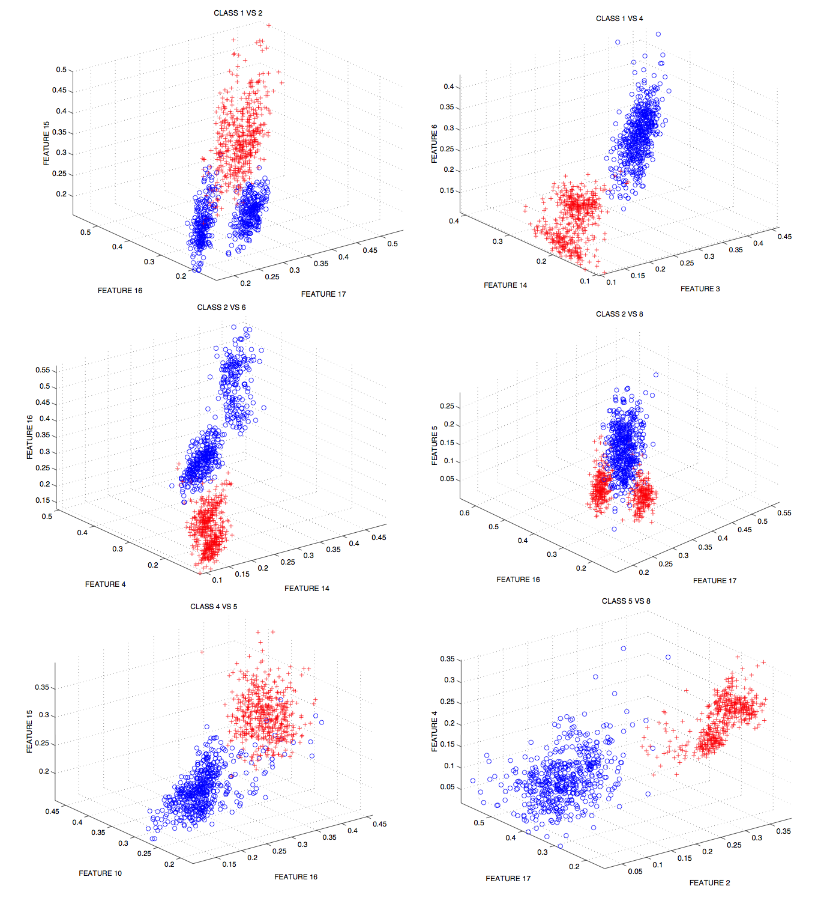
Features in Remote Sensing Data

Slide 37


